Slide 1
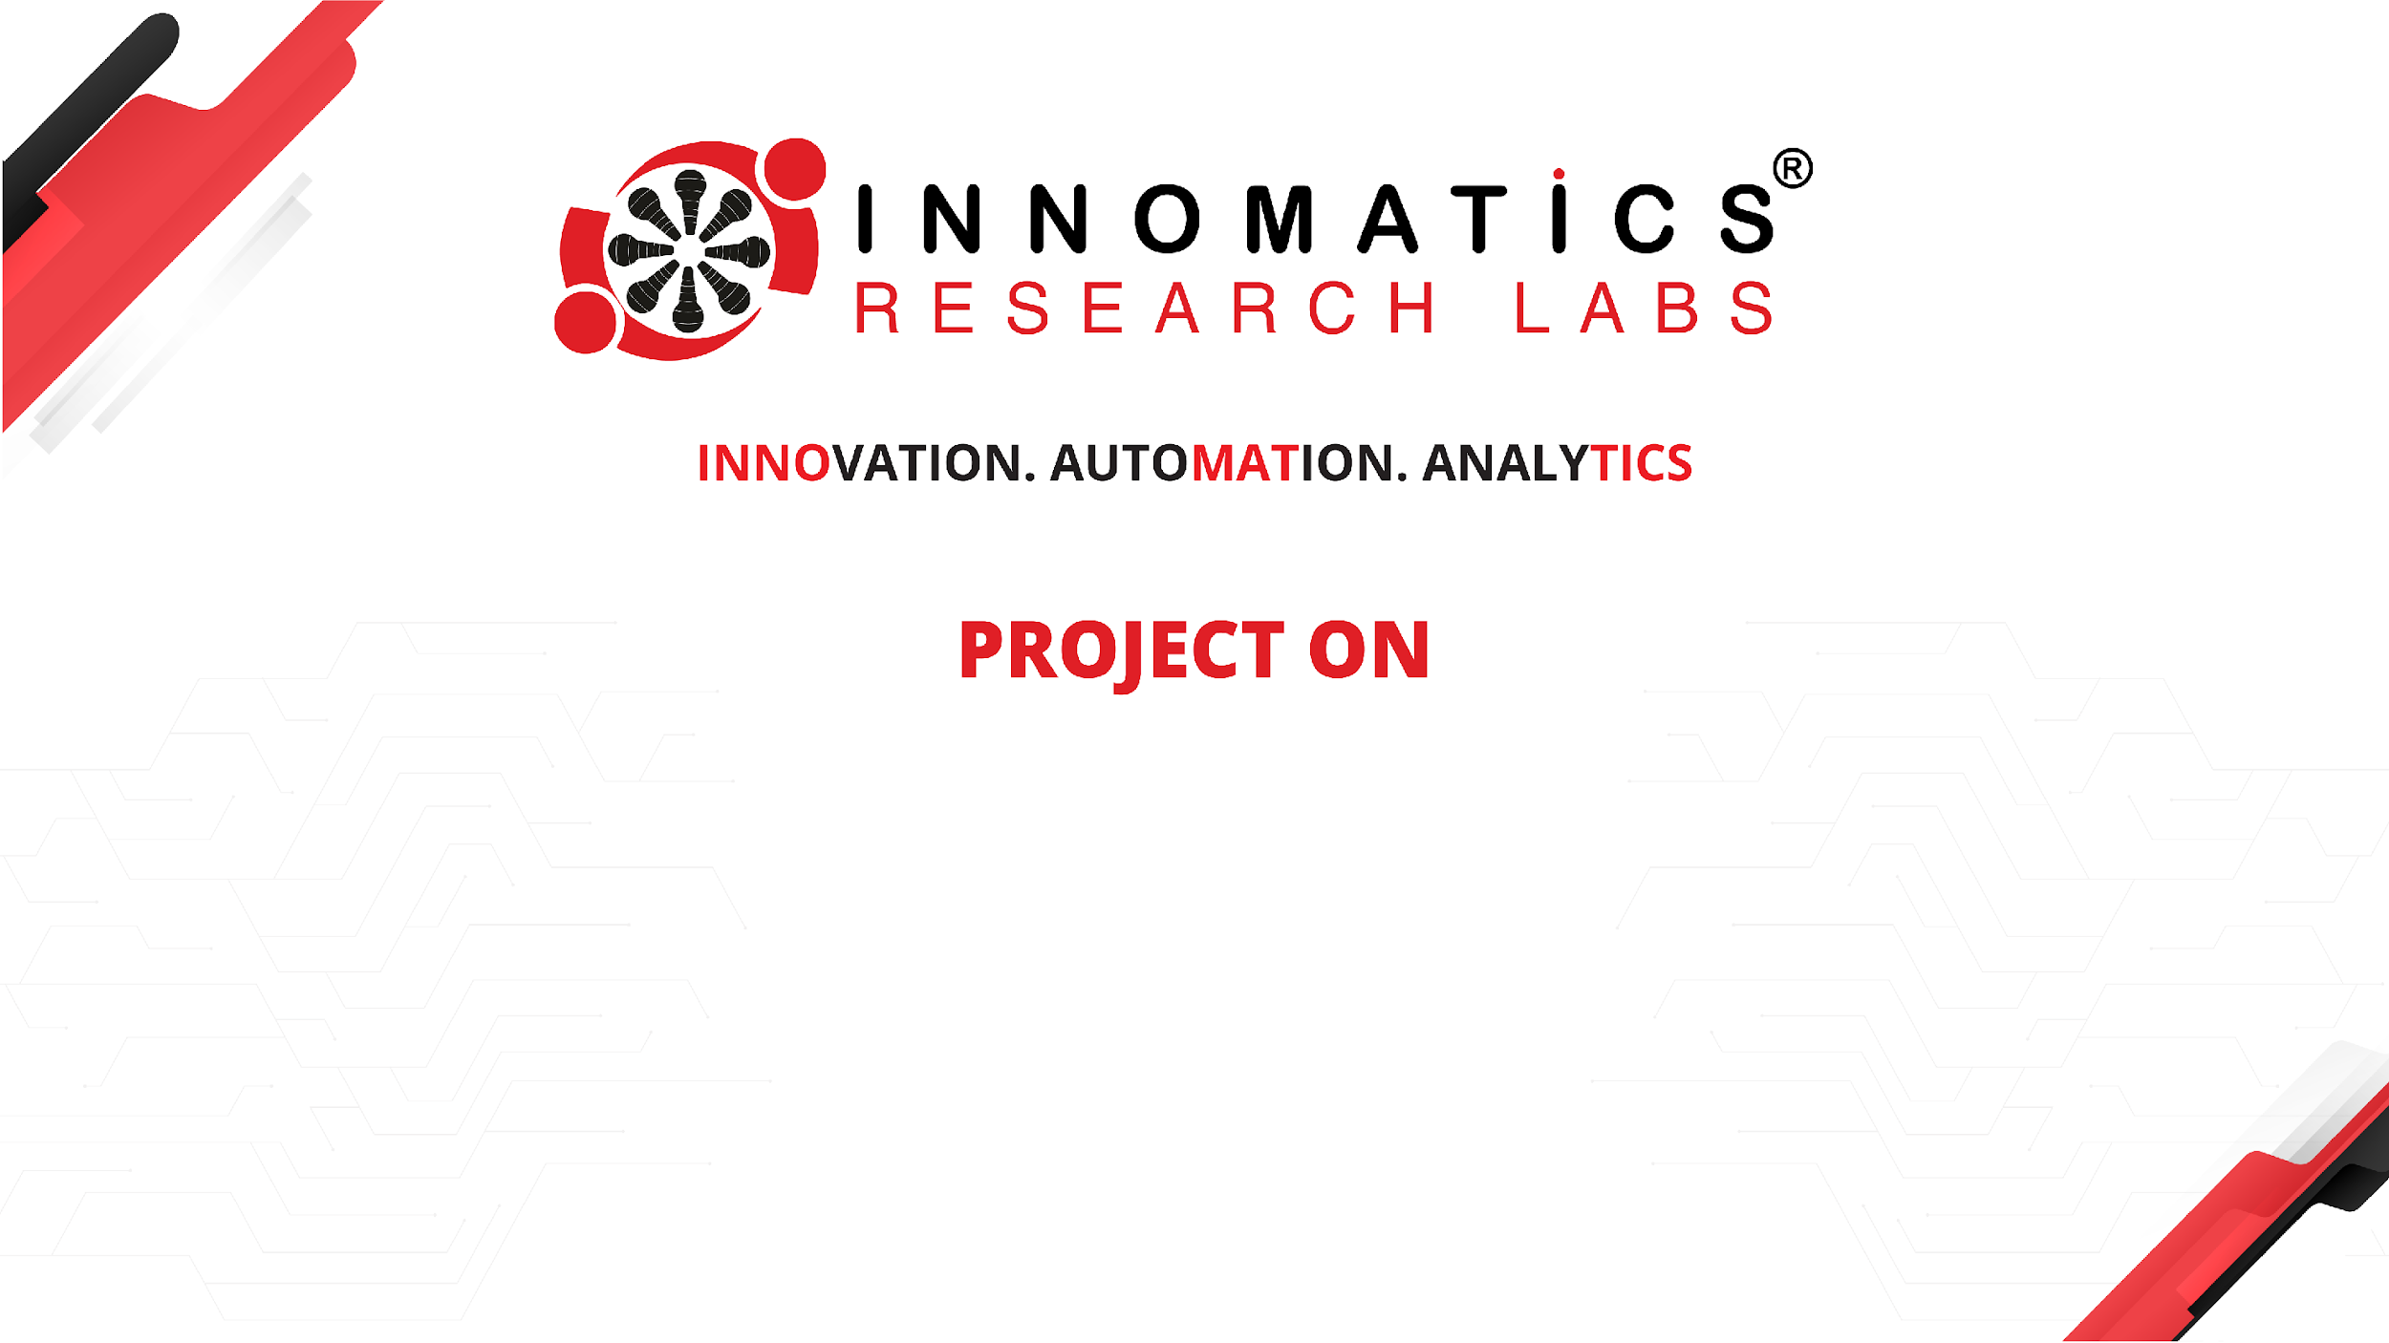
CODE REFACTORING AND BUG FIXING

Slide 2
About me
I am Sai Sujitha.
M.Sc. Biotechnology
As Data science is used in many Industries even in my stream of education so I choose data science.
LinkedIn - https://www.linkedin.com/in/sujitha-iragavarapu-840a9a78/
Github - https://github.com/Suji1612
Medium - https://medium.com/@sujisree9

Slide 3
Scenario:
A team of enthusiastic Data Scientists Embarked on am mission to develop a Note Taking Application Using Python , Flask, and HTML
However, their lack Of Experience in backend development has led to challenges in making the application fully functional
Recognizing Your proficiency In Backend Development, You have been Tasked with fixing the broken code and ensuring the application works seamlessly

Slide 4
Objective Of The Project:
Refactor the existing codebase and ensure the proper functioning of the Note Taking Application.
Document all Identified Bugs During the Debugging Process.
Remember, the Task is Not about Recreating the app from the Scratch
Your Goal is to Fix the Already existing Codebase make the Application Work as Intended.

Slide 5
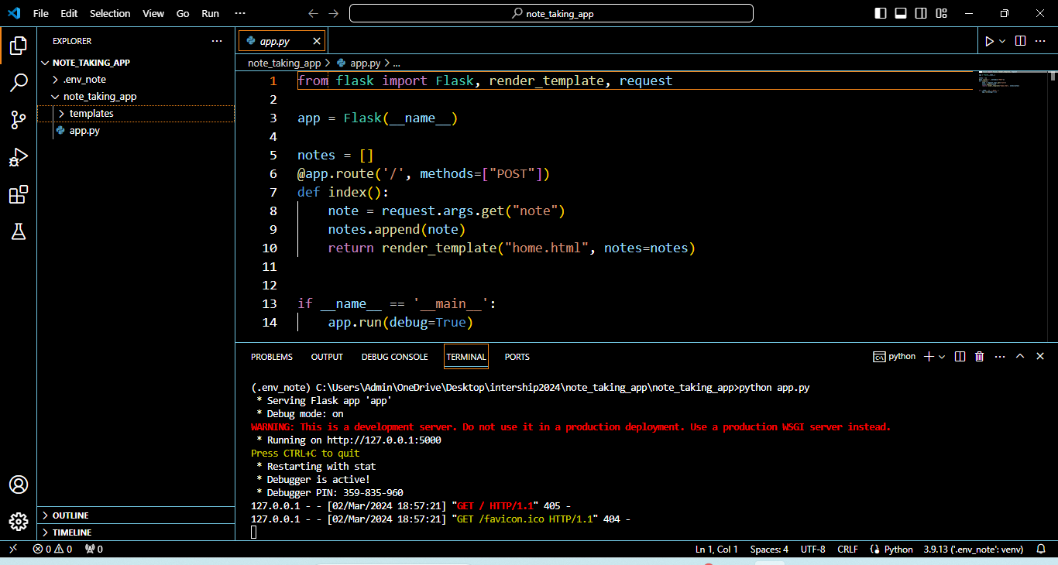
Identifying Bugs In The Application Server:

Slide 6
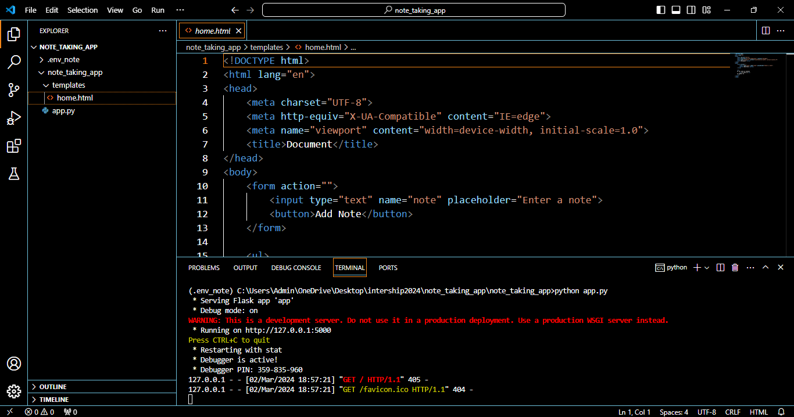
Identifying bugs in HTML method:

Slide 7
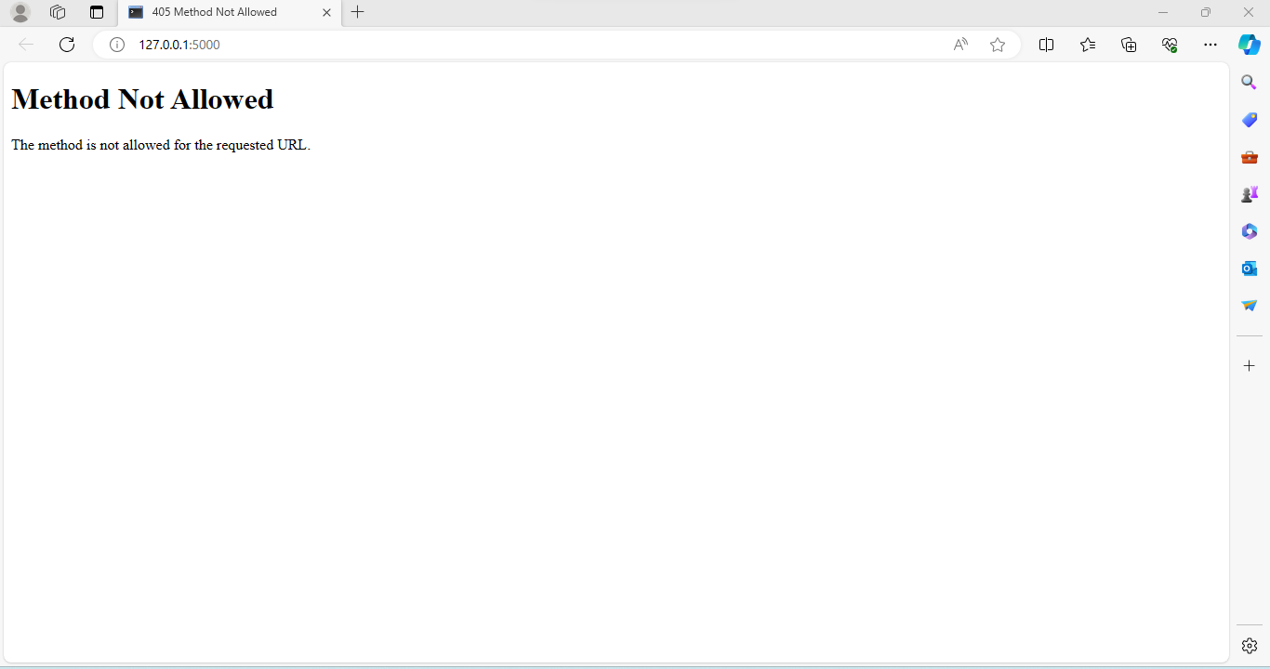
Output Before fixing Bugs :
Getty Images

Slide 8
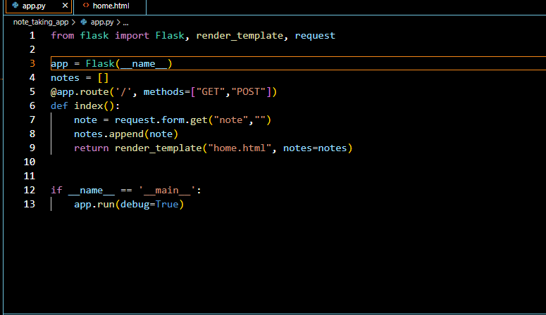
Fixing the Bugs In Application Server:

Slide 9
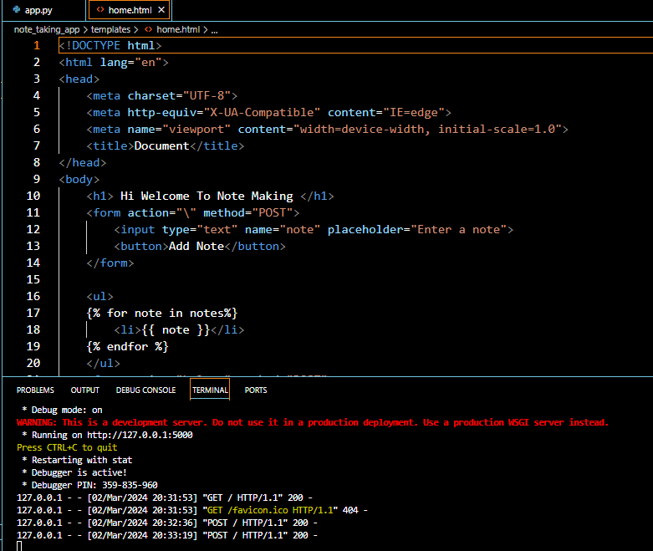
Fixing Bugs In HTML Method:

Slide 10
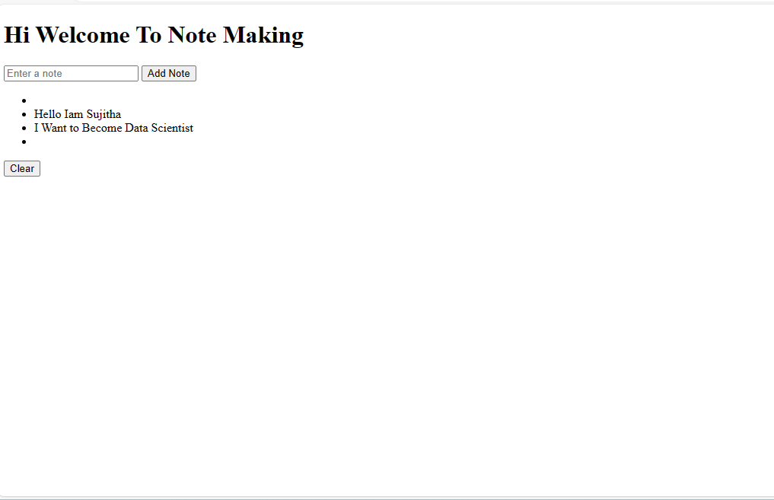
Final Output After Fixing Bugs:

Slide 11
Conclusion:
Throughout This Presentation, We Have Successfully Addressed Key Issues and Enhanced The Functionality Of Our Note Taking Application.
The Provided Code Has Been Refactored And Identified Bugs Have Been Fixed.
Implemented Features Like Handling Empty Notes And Adding a “Clear Button” to improve user Satisfaction.
Code Refactoring Is Conducted To Improve Readability and Maintainability.

Slide 12

THANK YOU

